Slide 1
The Dangle Tap
A quick method to collect clean catch urine in infants <12 weeks
Presentation by Claire Crouch Paediatric AMS nurse specialist.

Slide 2

Objectives
Understand the importance of collecting high quality urine from infants quickly.
Learn the dangle tap method.
Understand key points for successfully using the Dangle tap.

Slide 3
Why do we need a urine culture?
10-20 of infants <90days presenting with fever will have a urinary tract infection(UTI) (BSAC¹).
Urine samples help us to identify if the infant has a UTI.
And if they do, what bacteria is causing the infection, and what antibiotics will treat it.
Getting a high quality urine sample enables us to diagnose and treat UTI quickly, using as narrow spectrum antibiotic as possible.

Slide 4

Unwell febrile infants are often started on antibiotics empirically – this means they get a broad-spectrum antibiotic that will cover a range of infections and bacteria that cause them.
Its important to quickly identify the cause of infection and adjust the antibiotics.
Adjusting the antibiotics usually means stopping if no infection is found or changing to a narrow spectrum antibiotic if a UTI is identified – this often means using medicines that have less side effects, so the infant is exposed to less harms from antibiotics.
Sometimes the tests show bacteria that are resistant to the antibiotics being used. Changing treatment in this scenario ensures the infant is given effective treatment and doesn’t deteriorate or develop sepsis.

Slide 5
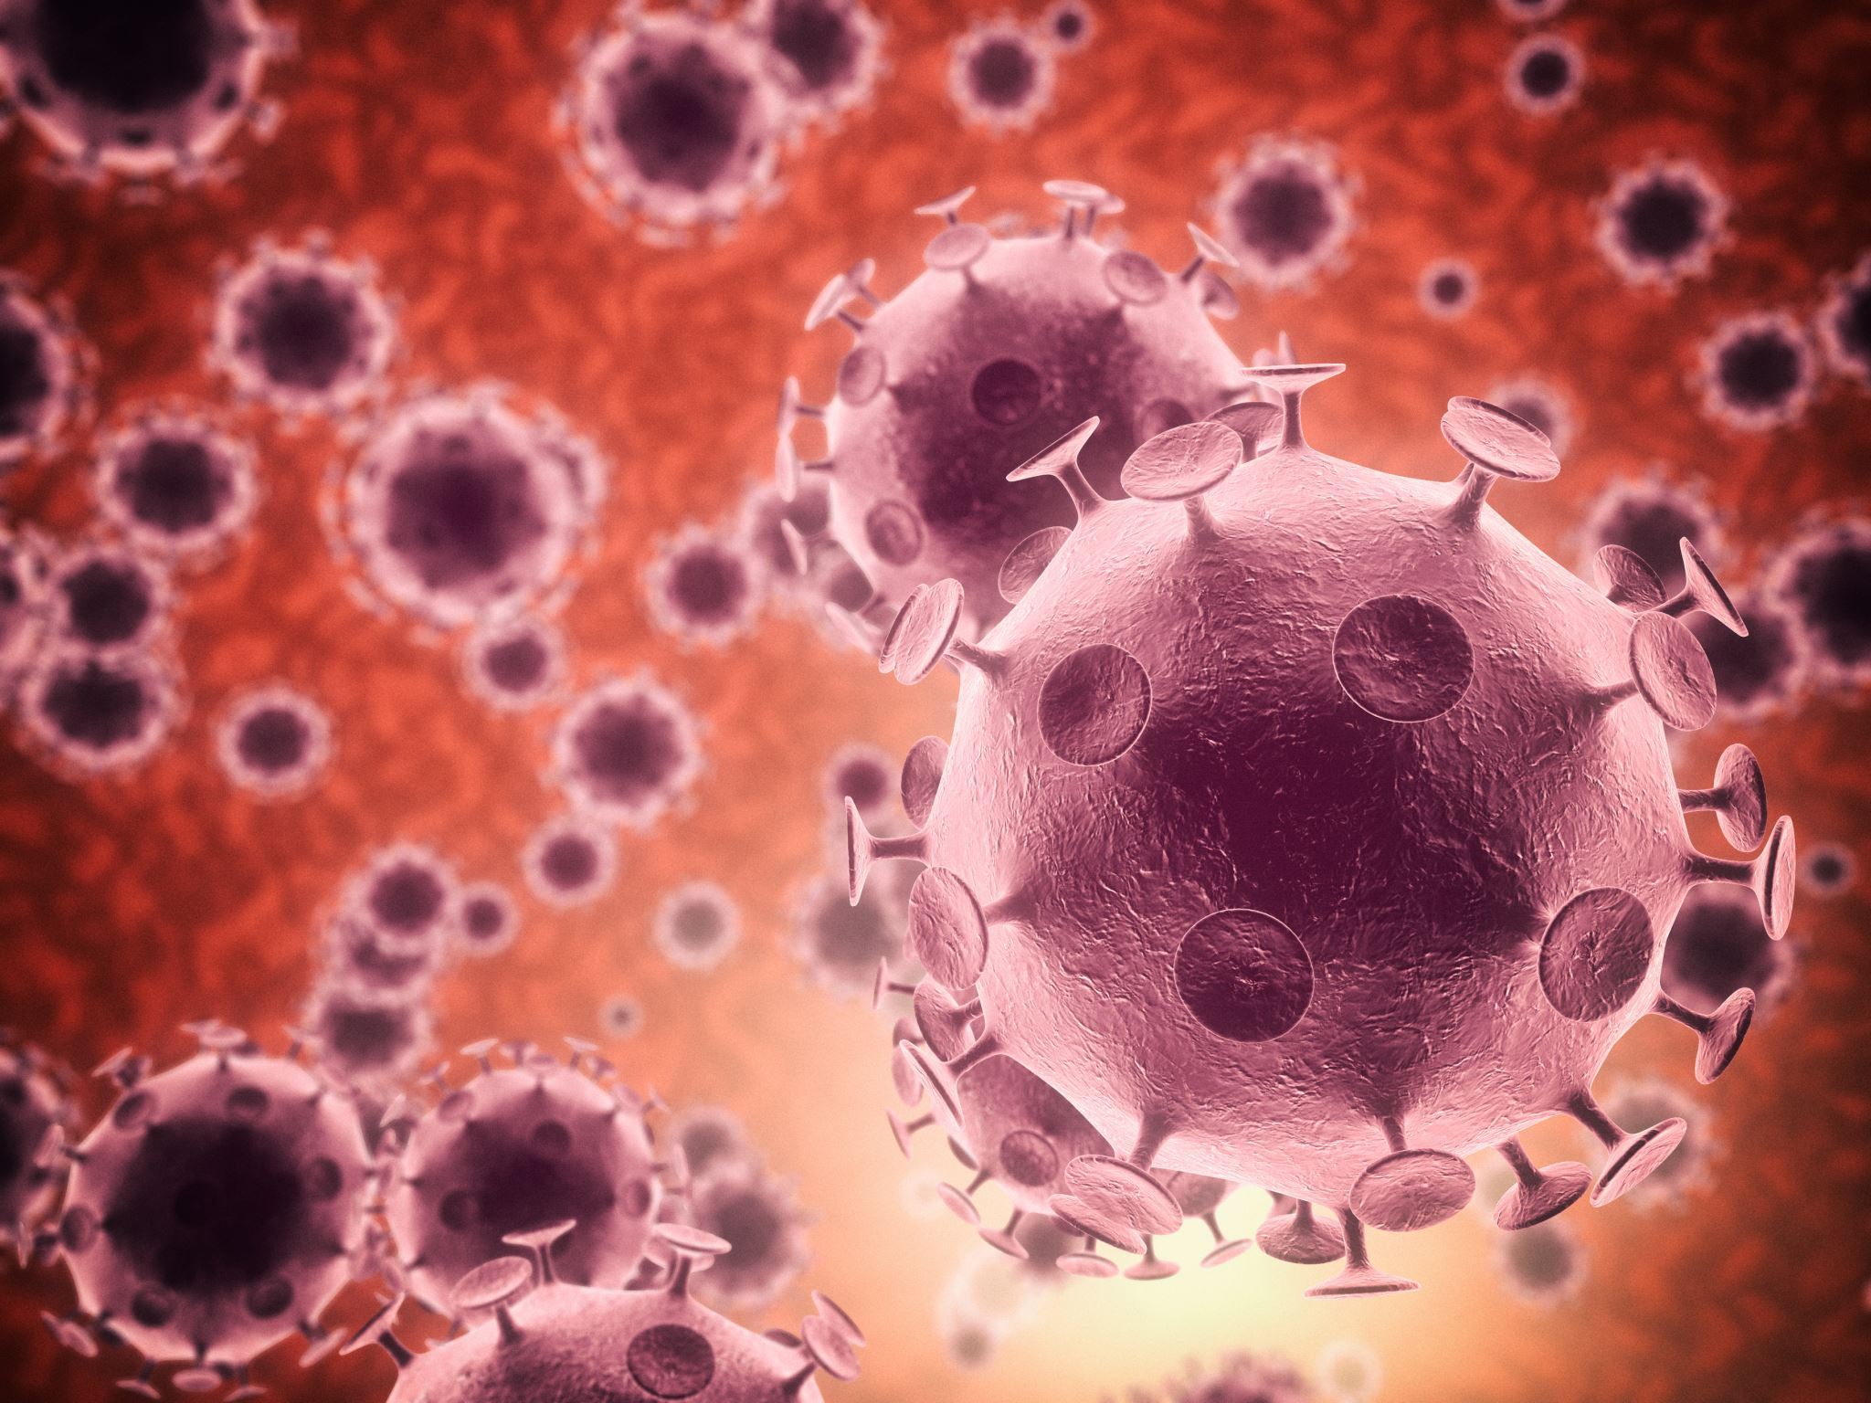
Antimicrobial Resistance
Antimicrobial resistance () has been identified by the World Health Organisation as a global health emergency. Around 5million deaths a year are related to resistance – over 2000 in the UK (UKHSA⁵ ).
“Antimicrobial Resistance occurs when bacteria, viruses, fungi and parasites no longer respond to antimicrobial medicines. As a result of drug resistance, antibiotics and other antimicrobial medicines become ineffective and infections become difficult or impossible to treat, increasing the risk of disease spread, severe illness, disability and death.
AMR is a natural process that happens over time through genetic changes in pathogens. Its emergence and spread is accelerated by human activity, mainly the misuse and overuse of antimicrobials to treat, prevent or control infections in humans, animals and plants.” (WHO 2023²).

Slide 6

Obtaining urine before antibiotics.
Once antibiotics are given urine samples rapidly become sterile (the bacteria are killed) (John et al 2022³). Our project at Alder Hey revealed no cephalosporin sensitive organisms grew after cefotaxime/ceftriaxone was given, even in samples obtained <1hour post antibiotics.
Therefore, urine for culture should be obtained BEFORE antibiotics are given.
Where there is suspected sepsis antibiotics should not be delayed if unable to collect urine in the same way abx are not delayed if unable to obtain a blood culture.
This Photo by Unknown Author is licensed under CC BY-SA

Slide 7
Using the dangle tap
The dangle tap is a method developed in Spain (Herreros et al 2013 ⁴). They reported an 86% success rate in rapidly collecting urine in neonates. https://adc.bmj.com/content/98/1/27
At Alder Hey we use the technique in infants up to 3 months. On our medical inpatient unit 84% of nurses report having used it successfully, obtaining urine form infants in less than 5 minutes.

Slide 8
The Dangle tap
Method | Notes/Rationale
Gather equipment: feed, sucrose, sterile sample pot, inco sheet, 2-3 people. | Parent/carer can assist as the “dangler”.
1. Feed the infant (breast or formula—usual feed volume). | Feeding the infant ensures they are hydrated.
2. 25 minutes after feeding clean the infant's nappy area with warm water and soap, and dry with sterile gauze. | Leaving a period of time after the feed, ensures the infant has a full bladder. Cleaning the infant reduces skin cells and flora which can cause contamination of the sample.
3. Have the sterile collection container to hand. | Ensure the container is held away from the body to avoid contaminating the sample.
4. Administer sucrose to the infant. | This can aid tolerance of the procedure.

Slide 9
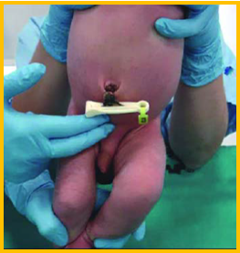
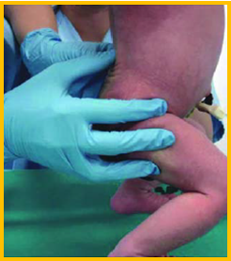

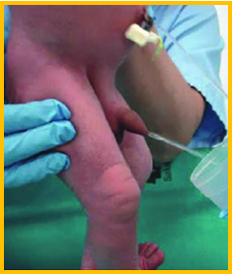

The dangle tap continued
Method | Notes/Rationale
5. Person 1: hold the baby under the armpits with their legs dangling. | If helping, this is the role the parent/carer can undertake.
6. Person 2: stimulate the bladder—> gently tap the suprapubic area at a rate of 100taps/minute for 30 seconds, (A) then stimulate the lower back with light circular massage for 30 seconds (B).
7. Continue rotating bladder and lumbar stimulation until the urine is obtained (C), this usually takes approx. 5minutes.
Secure the lid of the container and send the sample to the lab. | Avoid leaks with a secure lid. Prompt lab arrival ensures UTI and pathogen are identified quickly.
A
B
Ideally allow a small amount of urine to flow onto the inco sheet to flush out flora in the urethra, then catch a midstream sample in the container.

Slide 10

Key messages
Hydration is key to getting a urine sample quickly.
Using sucrose improves toleration of procedure.
Cleaning the baby and collecting a midstream sample reduces contamination.
Check the top is secure and send fast.

Slide 11
FAQ
Q: What if my patients are on IV fluids
A: You should attempt the technique if the infant is hydrated. Bladder scanning (if available) can ensure there is urine in the bladder.
Q:My patient isn’t stable, should I try the dangle tap?
A: No, this technique is not appropriate on unstable infants.
Q:How many people do you need to do a dangle tap
A: If you are confident in the technique, you can do the dangle tap with a willing parent/carer – they do the dangle while you tap and collect. If you are still new to the technique you should use at least 2-3 members of staff to support one another with one member dangling, 1 member taping/massaging and 1 member collecting.

Slide 12
References
1)Febrile infant aged <90 days. [online] Available at: https://bsac.org.uk/paediatricpathways/febrile-infant-aged-90-days.php [Accessed 21 Jul. 2025].
2) World Health Organization, 2023. Antimicrobial resistance. [online] Available at: https://www.who.int/news-room/fact-sheets/detail/antimicrobial-resistance [Accessed 21 Jul. 2025]
3)John, G., Mugnier, E., Pittet, E., Staehli, D., Clerc, O., Kenfak Foguena, A., Konasch, A., Lienhard, R. and Genné, D., 2022. Urinary culture sensitivity after a single empirical antibiotic dose for upper or febrile urinary tract infection: A prospective multicentre observational study. Clinical Microbiology and Infection, 28(6), pp.846.e1–846.e6.
4)Herreros, F.G., Tagarro, A., Sánchez, A., García-Pose, A. and Ruiz, P., 2013. A new technique for fast and safe collection of urine in newborns. Archives of Disease in Childhood, 98(1), pp.27–29. https://adc.bmj.com/content/98/1/27
5) UK Health Security Agency, 2023. Antibiotic resistant infections and associated deaths increase, 15 November. GOV.UK. Available at: gov.uk/government/news/antibiotic-resistant-infections-and-associated-deaths-increase [Accessed 24 July 2025].

